Slide 1

Big Data Analytics on Customer Purchase Behaviour in E-Commerce
A comprehensive analysis of customer purchasing patterns using advanced analytics and machine learning techniques to drive business intelligence and strategic decision-making in the digital retail landscape.

Slide 2

Capstone Project
Understanding E-Commerce Through Data
Presented By:
Patkula Vaishnavi
Roll No: (24MBMA29)
Program: MBA (General), 2024–26
Guided by: Sree Lakshmi Mam

Slide 3

Introduction & Strategic Objectives
E-commerce has fundamentally transformed retail through unprecedented convenience, granular personalization capabilities, and seamless digital payment integration. Customer behaviour analytics empowers organizations to anticipate market trends, deliver targeted offers, and strengthen customer loyalty.
Analyse Patterns
Understand purchase behaviour and seasonal trends
Predict Outcomes
Forecast likelihood and churn probability
Segment Customers
RFM analysis and advanced clustering
Maximize Value
Estimate lifetime value and CLV

Slide 4


Methodology & Technical Architecture
This project employs an exploratory and analytical approach across a dataset encompassing 5,000 customers and over 50,000 transactions, structured through a sophisticated data pipeline.
Bronze Layer
Raw data ingestion of transactions and customer demographics
Silver Layer
Data cleaning, transformation, and feature engineering (RFM metrics)
Gold Layer
Advanced modeling, predictions, and interactive visualizations
Tools: Databricks (Platform) • Python (Language) • Pandas, NumPy, Scikit-learn (Libraries) • Logistic Regression, Random Forest, K-Means, Gradient Boosting (Models) • Power BI & Databricks Dashboards (Visualization)

Slide 5
Key Analytical Applications & Model Performance
Use Case
Technique
Key Findings
Purchase Prediction
Logistic Regression, Random Forest
87% accuracy; Recency & Frequency are strongest drivers
Customer Segmentation
K-Means (RFM)
4 clusters identified: High-Value, Potential Loyal, At-Risk, Low-Value
Product Recommendation
Collaborative Filtering
75% precision; cross-category combos (phone → accessories)
Customer Lifetime Value
Gradient Boosting
High CLV linked to frequent, high-spend buyers (R²=0.82)
Churn Prediction
Decision Tree, Gradient Boosting
90% accuracy; inactivity >90 days signals elevated risk

Slide 6
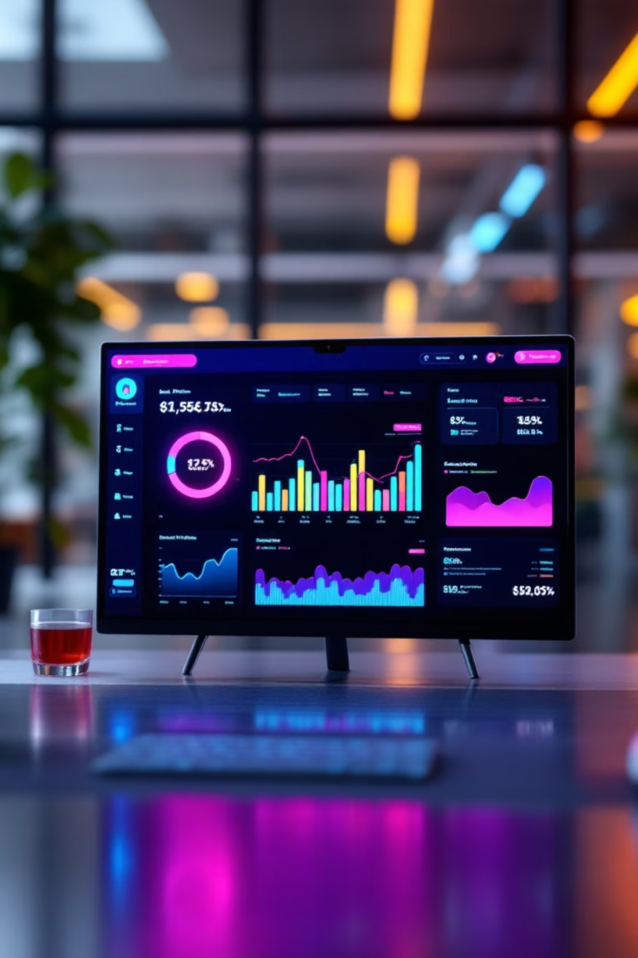
Critical Business Insights & Strategic Implications
1
Revenue Concentration
Top 15% of customers generate 60% of total sales, revealing classic Pareto distribution patterns that demand targeted retention strategies.
2
Recency Impact
Active buyers with purchases within 30 days demonstrate 72% higher repurchase probability, underscoring engagement's strategic importance.
3
Payment Behavior
Cash-on-delivery users exhibit slightly elevated churn tendency, suggesting opportunity for targeted payment incentives and loyalty programs.
4
Cross-Selling Success
Recommendation systems increase average basket value through intelligent product bundling across complementary categories.

Slide 7

Strategic Recommendations & Implementation Roadmap
Churn Prevention : Deploy real-time predictive alerts and personalized reactivation campaigns for at-risk segments
Loyalty Programs : Launch targeted initiatives for high-value customer clusters with tiered benefits and rewards
Real-Time Personalization : Integrate dynamic recommendation engines leveraging CLV predictions for instant customer engagement
Optimized Budgeting : Allocate marketing resources based on CLV-driven customer profitability scoring

Slide 8


Conclusion & Future Evolution
Big Data Analytics transforms e-commerce by enabling predictive customer intelligence, hyper-personalized marketing, and scientific retention planning. This Bronze–Silver–Gold pipeline architecture successfully translated raw transactional data into actionable business insights, substantially improving marketing precision and retention effectiveness.
Real-Time Analytics
Sentiment Analysis
Instant personalization through streaming data and edge computing
Extract customer insights from reviews, feedback, and social signals
Deep Learning Systems
Omnichannel Integration
Neural networks for sophisticated recommendation and behavior prediction
Unified data from social media, web behavior, and offline transactions

Slide 9
THANK YOU

